Slide 1



E-Commerce Product Analysis and Prediction
Using Clustering and Machine Learning
Python | SQL | Machine Learning
Abhinav D
DA & DS August

Slide 2
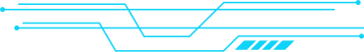


Introduction
E-commerce platforms generate large volumes of dynamic product data, including prices, ratings, and customer reviews, which change frequently based on market demand and user behavior.
Flipkart hosts a wide range of products across multiple categories, making it a valuable source for analyzing pricing patterns and customer engagement trends.
This project converts raw web data into structured datasets using automated scraping and preprocessing techniques.
This project converts raw web data into structured datasets and applies ML for analysis and prediction

Slide 3
Problem Statement
Product data is scattered across multiple web pages
Manual analysis is inefficient and error-prone
No centralized database for structured analytics
Limited insights into product segmentation and performance
Need for automated data extraction, storage, and ML-driven analysis

Slide 4
Project Objectives
Scrape Flipkart product data using Python
Clean and preprocess raw data
Store processed data in a SQL database
Perform EDA to identify patterns
Apply clustering for product segmentation
Build and compare supervised ML models

Slide 5
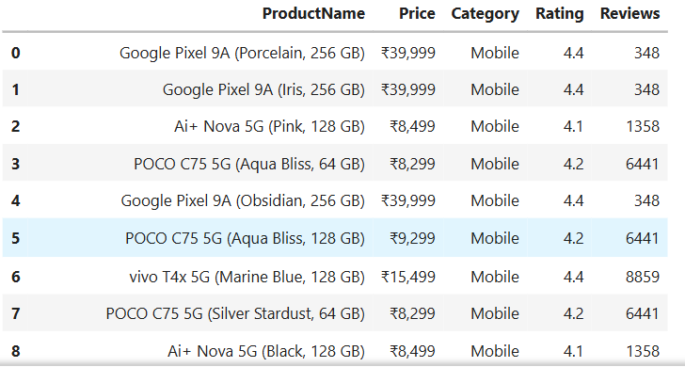
Dataset & Features
Illustration: Flipkart (Web Scraping)
Source: Flipkart (Web Scraping)
Features Used:
Product Name
Price
Category
Ratings
Number of Reviews
Categories Covered:
Mobiles, Laptops, Electronics, Televisions, Vehicles

Slide 6
Web Scraping using Selenium
Data Cleaning & Preprocessing (Pandas)
SQL Storage using MySQL & SQLAlchemy
Exploratory Data Analysis
Unsupervised Learning (K-Means)
Supervised Learning & Model Optimization
Project
Workflow

Slide 7

Data Cleaning & EDA
Handled missing values and duplicates
Standardized price and rating formats
Converted features to correct data types
EDA performed:
Price distribution
Ratings vs reviews
Category-wise analysis
Correlation analysis

Slide 8
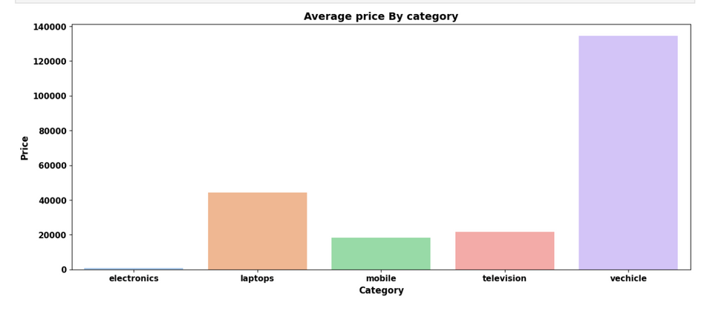
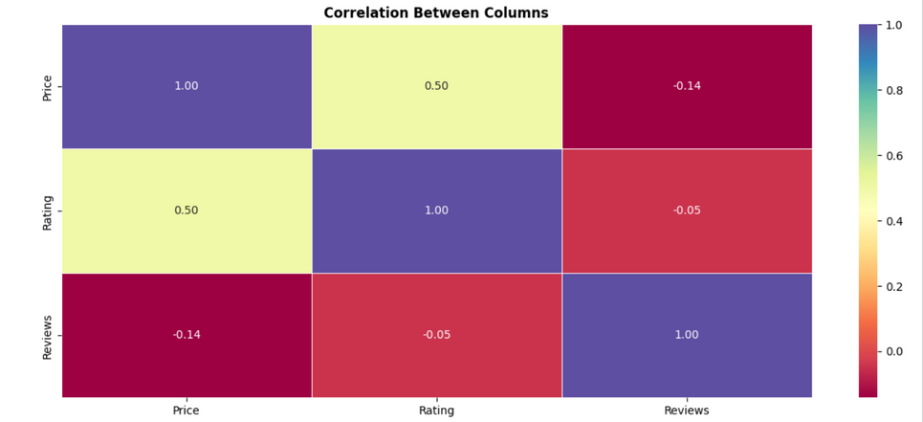
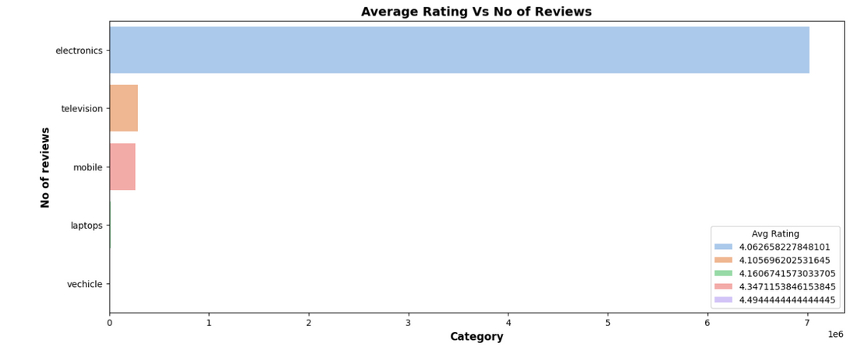
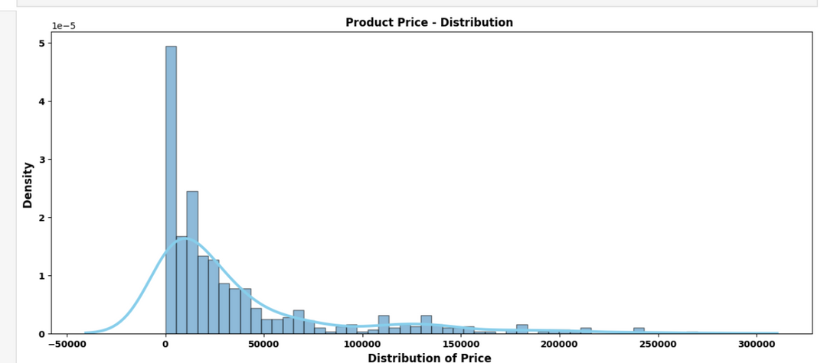
Data Visualization

Slide 9

SQL Data
Storage
Designed relational database schema
Connected Python to MySQL using SQLAlchemy
Stored cleaned and structured data in SQL tables
Enabled efficient querying and scalability for modeling

Slide 10
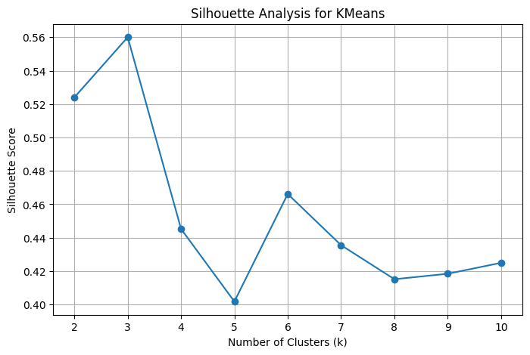
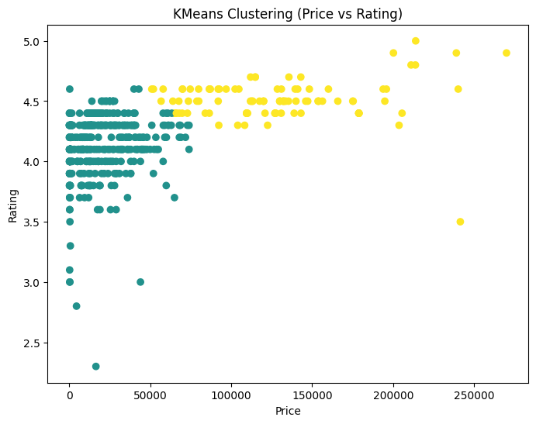
K-Means Clustering - Cluster Interpretation
Objective: Identify natural product groupings without labels
Features Used:
Price
Rating
Reviews
Preprocessing:
Feature scaling using StandardScaler
Cluster Selection:
Tested multiple values of k
Used Silhouette Score to validate clustering quality
Cluster Insights:
Low-price products: high reviews, moderate ratings
Mid-range products: balanced price and engagement
Premium products: high price, high ratings, fewer reviews

Slide 11
Supervised Learning Models
Models Implemented:
Logistic Regression
SVM
KNN
Random Forest
XGBoost
Evaluation Metrics:
Accuracy
Precision
F1 Score

Slide 12
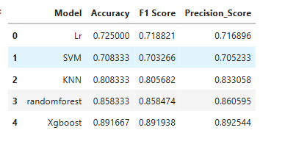
Model Comparison Results
Illustration:
Ensemble models outperformed traditional models
XGBoost achieved highest accuracy and F1 score
Random Forest showed strong performance but lower than XGBoost
XGBoost handled non-linear feature interactions effectively

Slide 13
Hyperparameter Tuning & Final Model
Hyperparameter tuning using GridSearchCV (5-fold CV)
Tuned XGBoost parameters:
n_estimators, max_depth, learning_rate
subsample, colsample_bytree
Tuned model showed better generalization and stability
Final Model Selected: XGBoost
Final Tuned XGBoost Accuracy: 0.85
Precision: 0.86
F1_Score: 0.86

Slide 14
Conclusion
Built an end-to-end e-commerce data pipeline
Successfully integrated scraping, SQL storage, clustering, and ML
K-Means revealed meaningful product segments
XGBoost delivered best predictive performance after tuning
Project demonstrates practical and scalable ML application
-

